Slide 1
Project 3: behavior of school metrics and crime rates in Philadelphia
Presented by:
Elizabeth Vandergrift
Juan Camilo Bohorquez Rozo
Eric Croston

Slide 2
The Data
OpenDataPhilly.org
Police Stations
Schools
Zip Code Boundaries
PSA Boundaries
Crime Incidents January 2024- July 2024
PhilaSD.org
SPREE 2023 School Performance

Slide 3
School Metrics

Slide 4
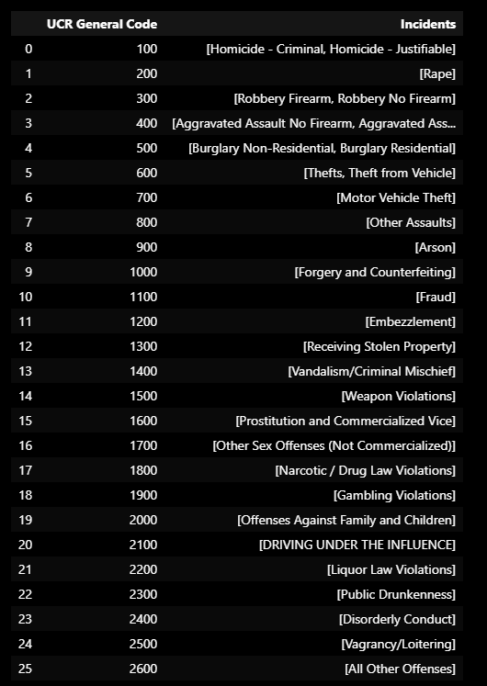
Crime incidents
There were 85,529 Crime Incidents Documented by the Philadelphia Police Department From January 1st, 2024 until July 17th, 2024.
For Each Crime there is a Numerical Code and Incident Description.
There are 26 different unique incident types with specific codes.

Slide 5
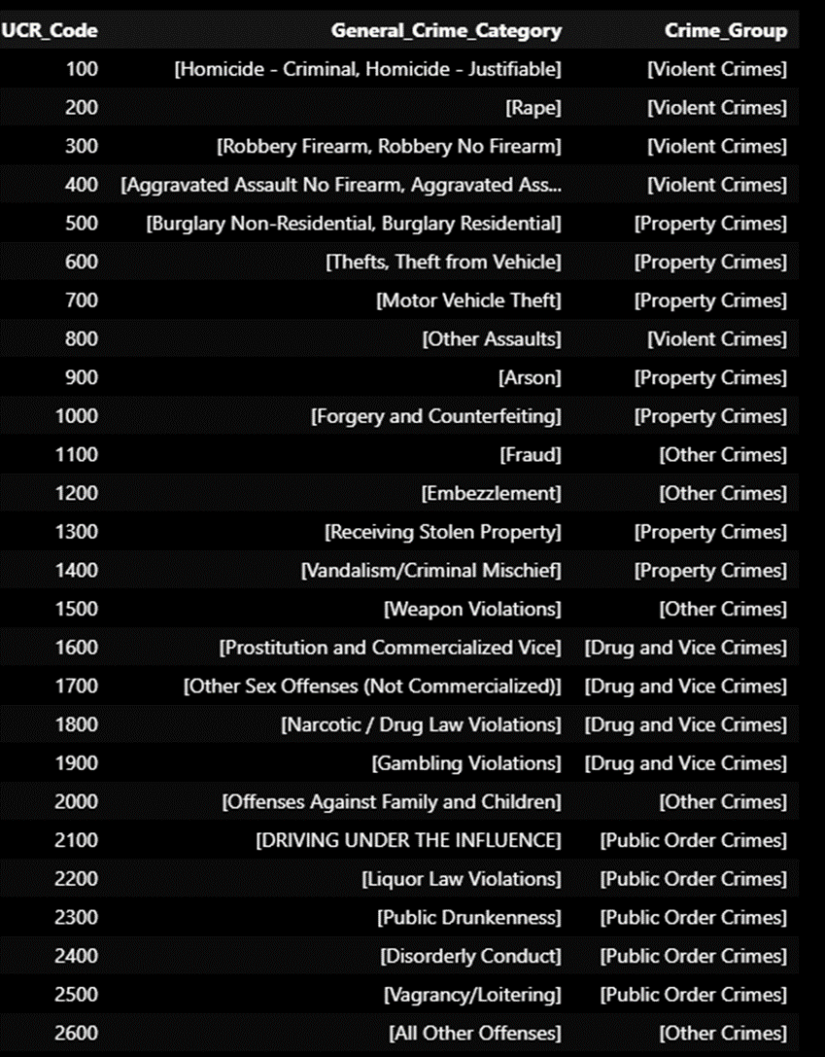
Crime incidents
Crime Incident Types were grouped into related crime categories to be able to make comparisons.
'Violent Crimes': ['Homicide - Criminal', 'Homicide - Justifiable', 'Rape', 'Robbery No Firearm', 'Robbery Firearm', 'Aggravated Assault Firearm', 'Aggravated Assault No Firearm', 'Other Assaults’],
'Property Crimes': ['Burglary Residential', 'Burglary Non-Residential', 'Thefts', 'Theft from Vehicle’, ‘Motor Vehicle Theft', 'Arson’, ‘Forgery and Counterfeiting', 'Receiving Stolen Property', 'Vandalism/Criminal Mischief’],
Public Order Crimes': ['Disorderly Conduct', 'Vagrancy/Loitering', 'Public Drunkenness', 'Liquor Law Violations', 'DRIVING UNDER THE INFLUENCE’],
'Drug and Vice Crimes': ['Prostitution and Commercialized Vice', 'Narcotic / Drug Law Violations', 'Other Sex Offenses (Not Commercialized)', 'Gambling Violations’],
'Other Crimes': ['Offenses Against Family and Children', 'Fraud', 'Embezzlement', 'Weapon Violations', 'All Other Offenses’

Slide 6
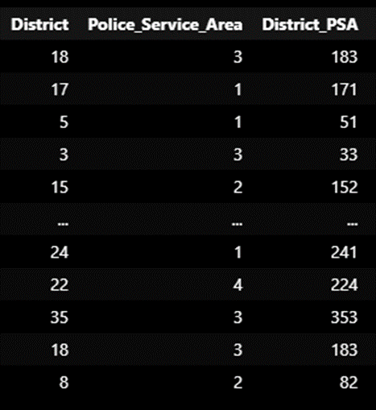

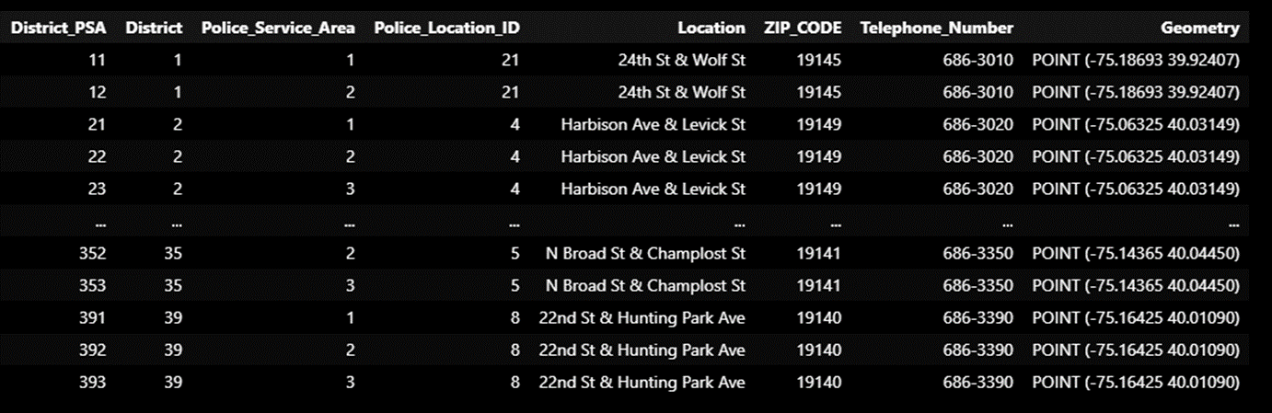
Creating a composite key for District PSA including the District and the Police Service Area number within that District
District PSA composite added to Police Station Location and Police Incident locations

Slide 7
How are We Going to Connect over 85K Incident locations with Schools and Their Metrics????
Our plan was to use ZIP Codes….

Slide 8
But that did not work….
Only some files had ZIP Codes, and the largest file with Police Incidents (85K rows) did not!
We also found looping through 85K rows of data to determine if a school point is within the same polygon Zip Code of a crime was not easily possible.
Possibly, we could find the common ZIP Codes by using the Police Station Coordinates and School Coordinates in the ZIP Code?
However, this does not account for Crimes handled by the Police District in Different ZIP Codes. ZIP Codes and Police Districts- Police Service Area are not aligned.
Then we found another plan….

Slide 9
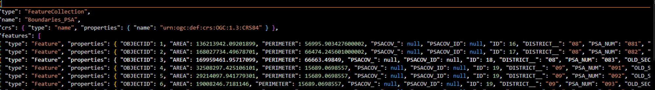
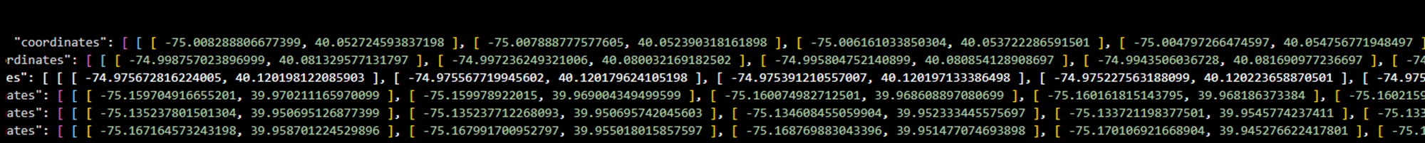
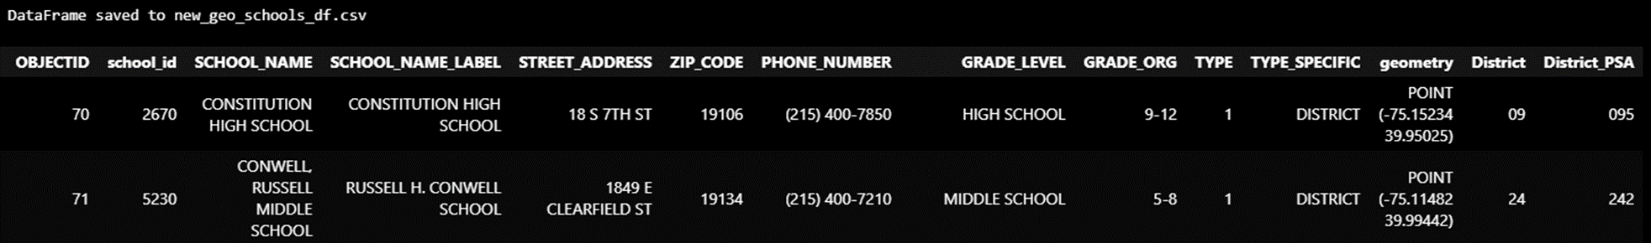
Police Service Area boundaries GeoJson File and School Coordinates

Slide 10
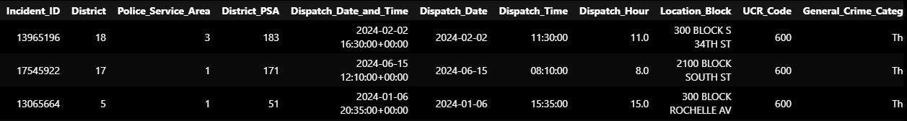



Connecting School Locations and Police Service Areas Incident Locations Using a Combination Key and Points within the Service Area Polygon
Using Two smaller datasets to be able to connect the larger data sets

Slide 11
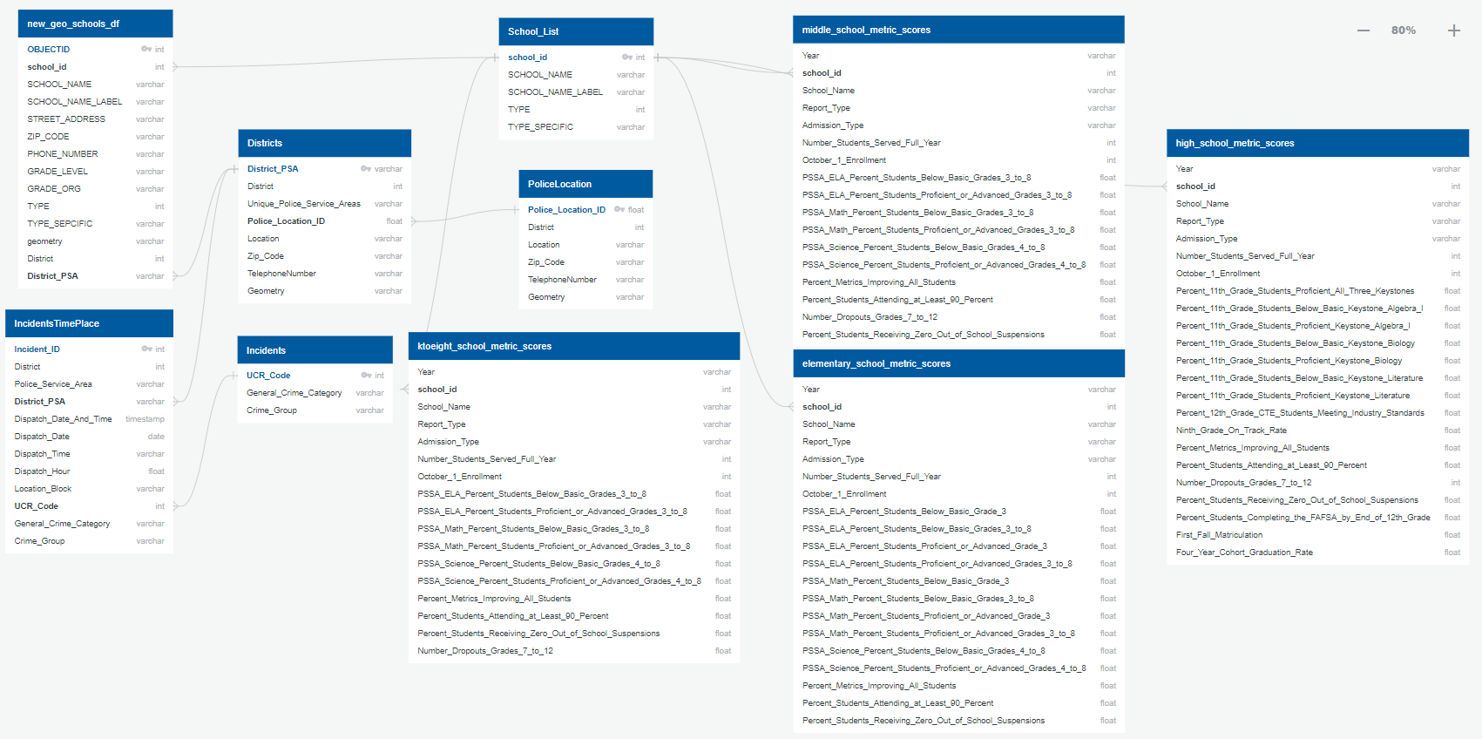




Entity Relationship Diagram (ERD)

Slide 12
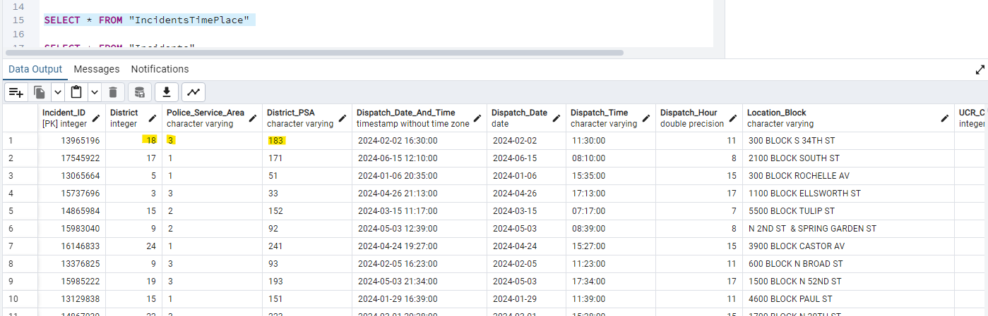
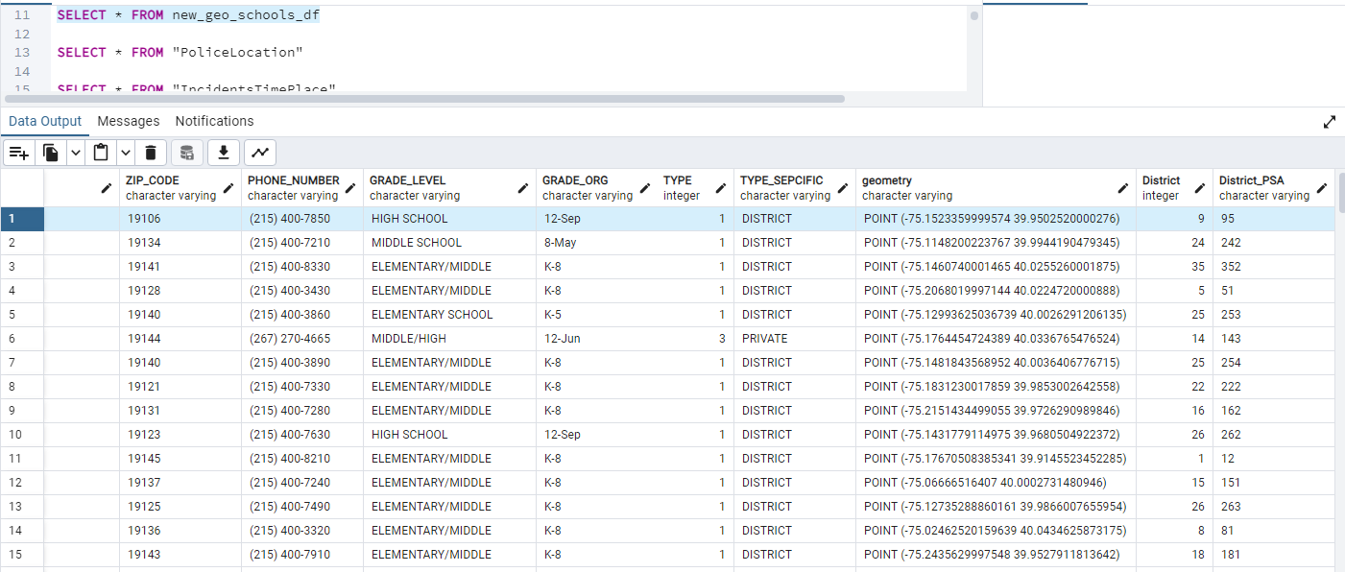


Crime incidents Locations And School Locations

Slide 13
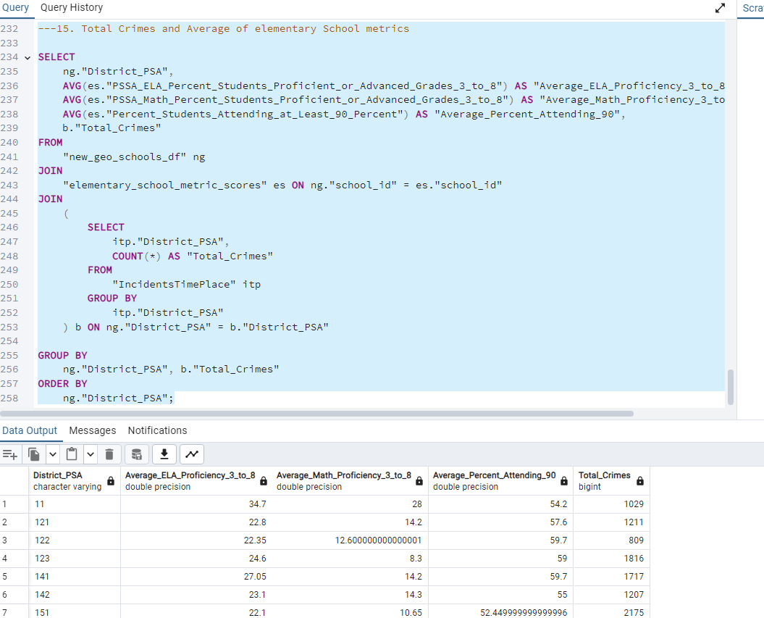





Crime incidents And School Metrics

Slide 14
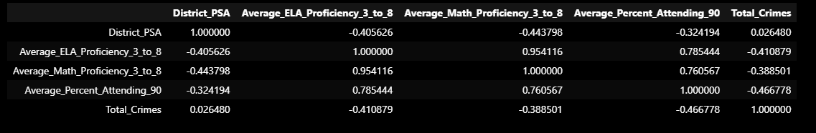
Analysis
When this Crime Incidents and School Metrics for Elementary Schools was exported from SQL and added as a Panda’s DataFrame, it was found that there was a correlation between Crime and Schools Metrics.

Slide 15
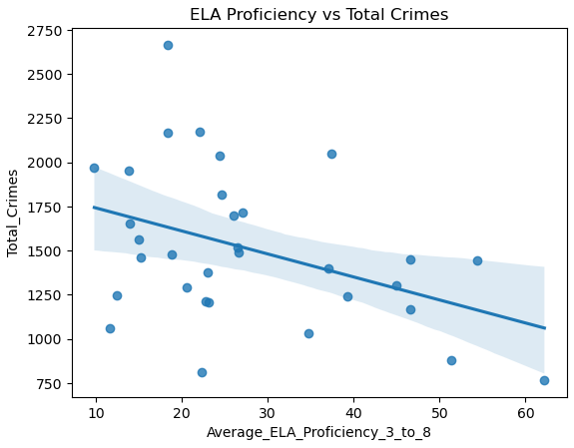
Analysis- With PandaS Dataframe
and Now we will analyze with Java Script Visualizations

Slide 16
Thank you
Elizabeth Vandergrift
Juan Camilo Bohorquez Rozo
Eric Croston

Slide 17

The power of communication

Slide 18

Overcoming nervousness
Confidence-building strategies

Slide 19
Selecting visual aids
Enhancing your presentation

Slide 20
Effective delivery techniques
This is a powerful tool in public speaking. It involves varying pitch, tone, and volume to convey emotion, emphasize points, and maintain interest:
Pitch variation
Tone inflection
Volume control
Effective body language enhances your message, making it more impactful and memorable:
Meaningful eye contact
Purposeful gestures
Maintain good posture
Control your expressions

Slide 21
Navigating Q&A sessions
Know your material in advance
Anticipate common questions
Rehearse your responses
Maintaining composure during the Q&A session is essential for projecting confidence and authority. Consider the following tips for staying composed:
Stay calm
Actively listen
Pause and reflect
Maintain eye contact

Slide 22

Speaking impact
Your ability to communicate effectively will leave a lasting impact on your audience
Effectively communicating involves not only delivering a message but also resonating with the experiences, values, and emotions of those listening

Slide 23
Dynamic delivery
Learn to infuse energy into your delivery to leave a lasting impression
One of the goals of effective communication is to motivate your audience
Metric | Measurement | Target | Actual
Audience attendance | # of attendees | 150 | 120
Engagement duration | Minutes | 60 | 75
Q&A interaction | # of questions | 10 | 15
Positive feedback | Percentage (%) | 90 | 95
Rate of information retention | Percentage (%) | 80 | 85

Slide 24
Final tips & takeaways
Consistent rehearsal
Strengthen your familiarity
Refine delivery style
Pacing, tone, and emphasis
Timing and transitions
Aim for seamless, professional delivery
Practice audience
Enlist colleagues to listen & provide feedback
Seek feedback
Reflect on performance
Explore new techniques
Set personal goals
Iterate and adapt

Slide 25
Navigating Q&A sessions
Impact factor | Measurement | Target | Achieved
Audience interaction | Percentage (%) | 85 | 88
Knowledge retention | Percentage (%) | 75 | 80
Post-presentation surveys | Average rating | 4.2 | 4.5
Referral rate | Percentage (%) | 10 | 12
Collaboration opportunities | # of opportunities | 8 | 10

